Slide 1
Youtube Trends
2017-18 (NOV-may)
Canada
Germany
France
England
U.S.A
By-
Raunak Singh,
7906859228

Slide 2
Index
Topics Covered | Pages
Canada | 4-6
France | 7-9
Germany | 10-12
Great Britain | 13-15
United States of America | 16-18
Complete insights | 19-20

Slide 3
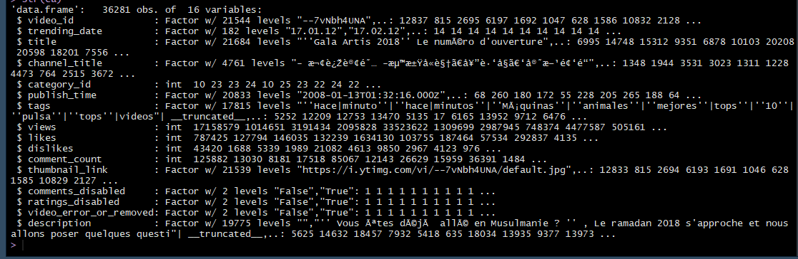
The Dataset
Common Structure of all Data Sets
Common Columns
VIDEO_ID
TRENDING_DATE
TITLE
PUBLISH_TIME
TAGS
CATEGORY_ID
VIEWS
LIKES
DISLIKES
COMMENT_COUNT
DESCRIPTION
Kaggle.com

Slide 4
Let ’s Talk about Canada first…..

Slide 5
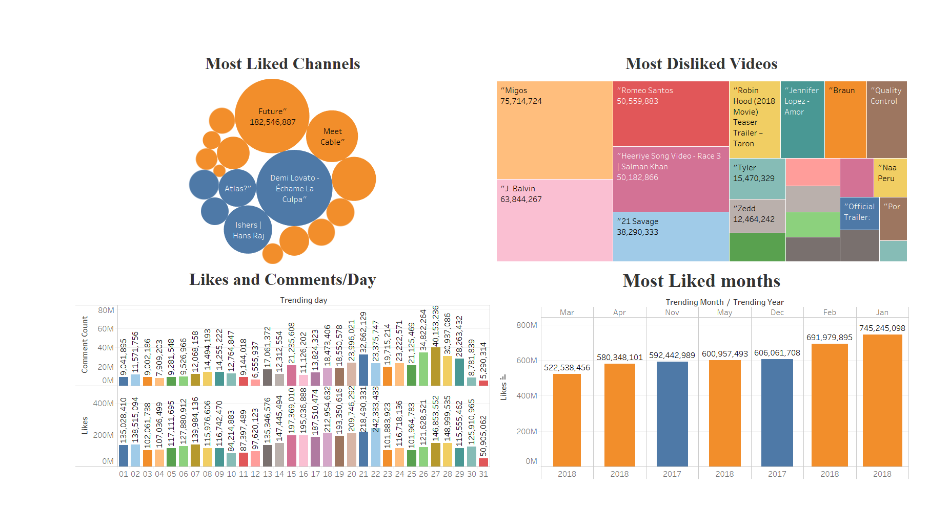
CANADA

Slide 6
Insights From CANADA DataSet
Most Liked Channel is “Future”
Most Disliked Video is ”Migos”
Most Likes were pushed on January 2018
Least active month was March 2018
Most active day was 21st of any month
Least active was the 31st of the month

Slide 7
Let ‘s talk about France….

Slide 8
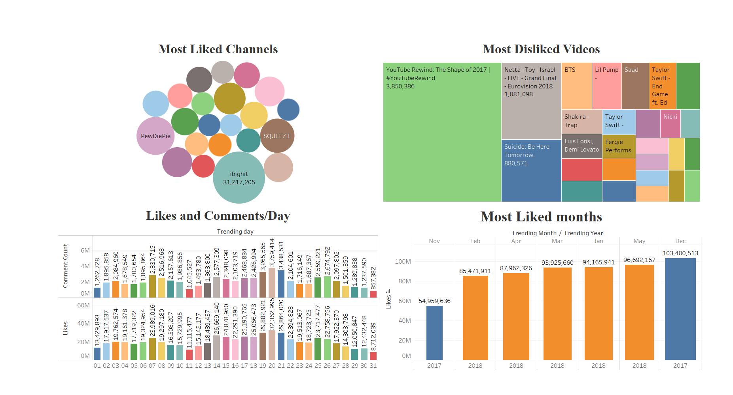
FRANCE

Slide 9
Insights From France DataSet
Most Liked Channel is “IBIGHiT”
Most Disliked Video is ”Youtube Rewind” the shape of 2017”
Most Likes were pushed on DEcember 2018
Least active month was November 2018
Most active day was 20th of any month
Least active was the 31st of the month

Slide 10
Let ‘s talk about germany….

Slide 11
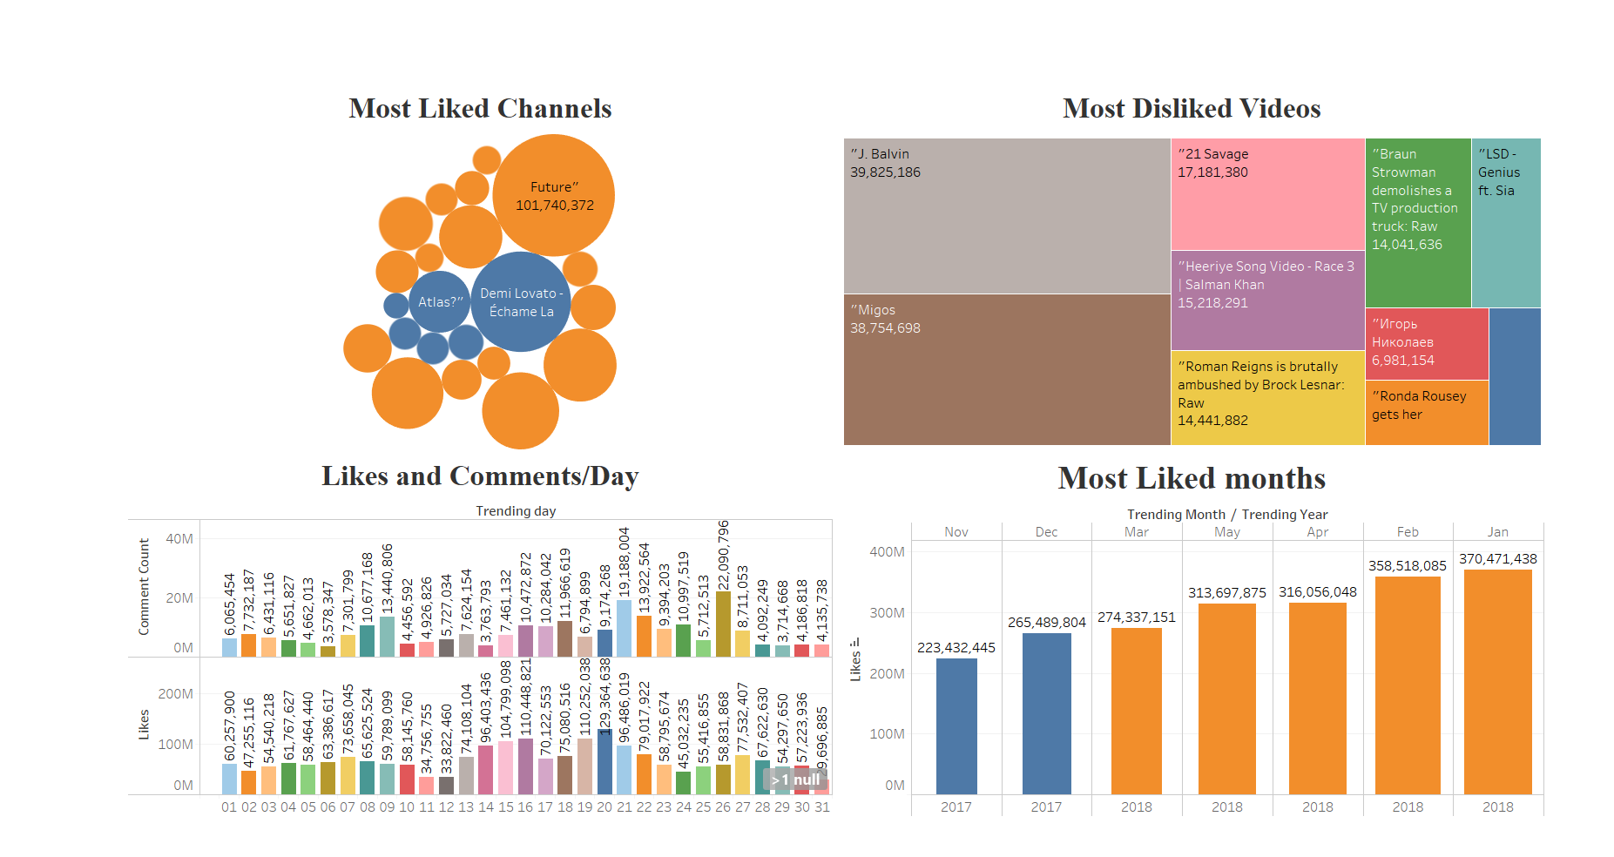
Germany

Slide 12
Insights From Germany DataSet
Most Liked Channel is “FUture”
Most Disliked Video is ”j.balvin”
Most Likes were pushed on January 2018
Least active month was November 2018
Most active day was 20th ( Likes ) and 21st ( comments ) of any month
Least active was the 31st of the month

Slide 13
Let ‘s talk about Great britain….

Slide 14
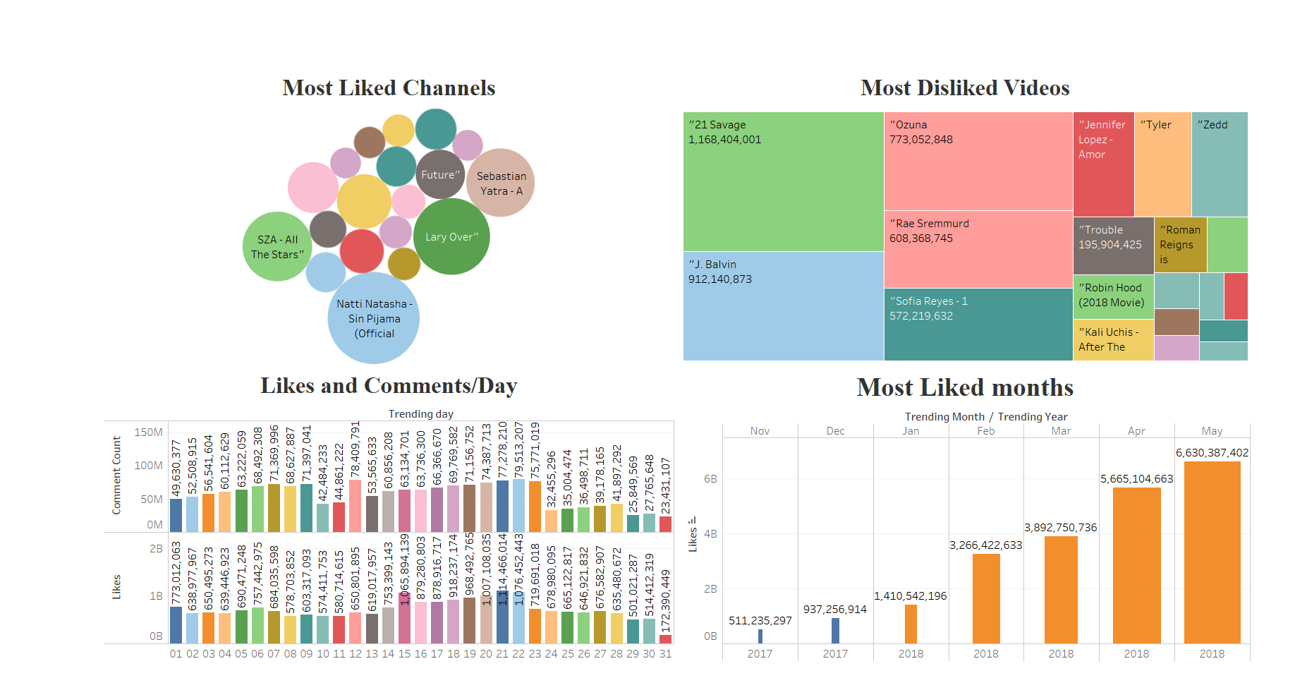
Great Britain

Slide 15
Insights From great britain DataSet
Most Liked Channel is “natti natasha”
Most Disliked Video is ”21 savage”
Most Likes were pushed on may 2018
Least active month was November 2018
Most active day was 22nd ( Likes ) and 21st ( comments ) of any month
Least active was the 31st of the month

Slide 16
Let ‘s talk about united states of america….

Slide 17
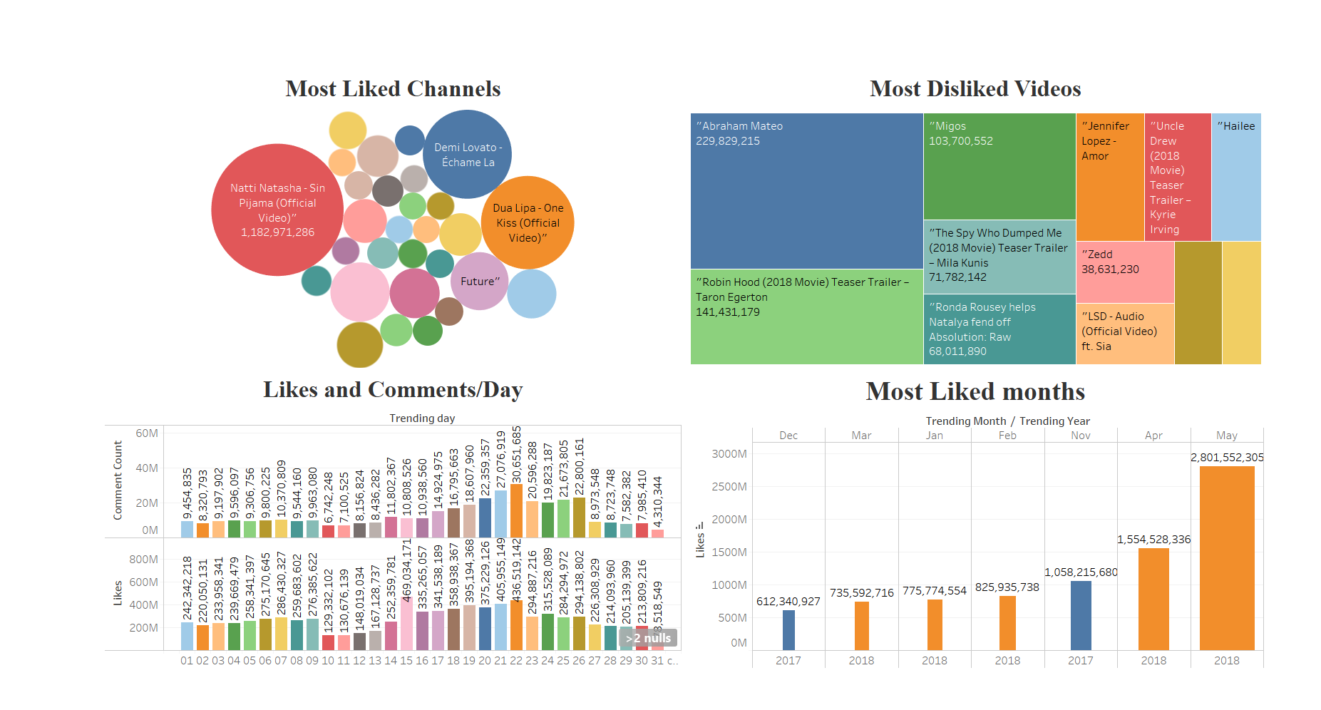
United States Of America

Slide 18
Insights From united stats of America DataSet
Most Liked Channel is “natti natasha”
Most Disliked Video is ”Abraham mateo”
Most Likes were pushed on may 2018
Least active month was December 2018
Most active day was 22nd of any month
Least active was the 31st of the month

Slide 19
Let ‘s have a look on the complete dataset….

Slide 20
Insights From complete DataSet
Most Liked Channel is “future” for being able to make in the list of almost all countries
Most Disliked Video is ” migos and 21 savage ” for being in all countries.
Most Likes were pushed on may 2018
Least active month was november 2018
Most active day was 22nd and 21st of any month
Least active was the 31st of the month
Great Britain is the country with most active users
France is the country with least active users
AS per the increasing trends june , 2018 could be forecased as the most actively used month

Slide 21
Thank You
Waiting to hear from you eagerly….

